Slide 1
Power Analysis by Simulation: Annoying and Time-Consuming, but Probably our Only Real Shot. Anyway, Here’s How You Do It!
Björn Jörges

Slide 2
Introduction
What are power analyses? Why are power analyses?
Power analyses via simulations
What is the general idea behind this approach?
The examples:
Two-Alternative Forced-Choice Task
Reaction Time Task
Hands-on part

Slide 3
INTRODUCTION

Slide 4
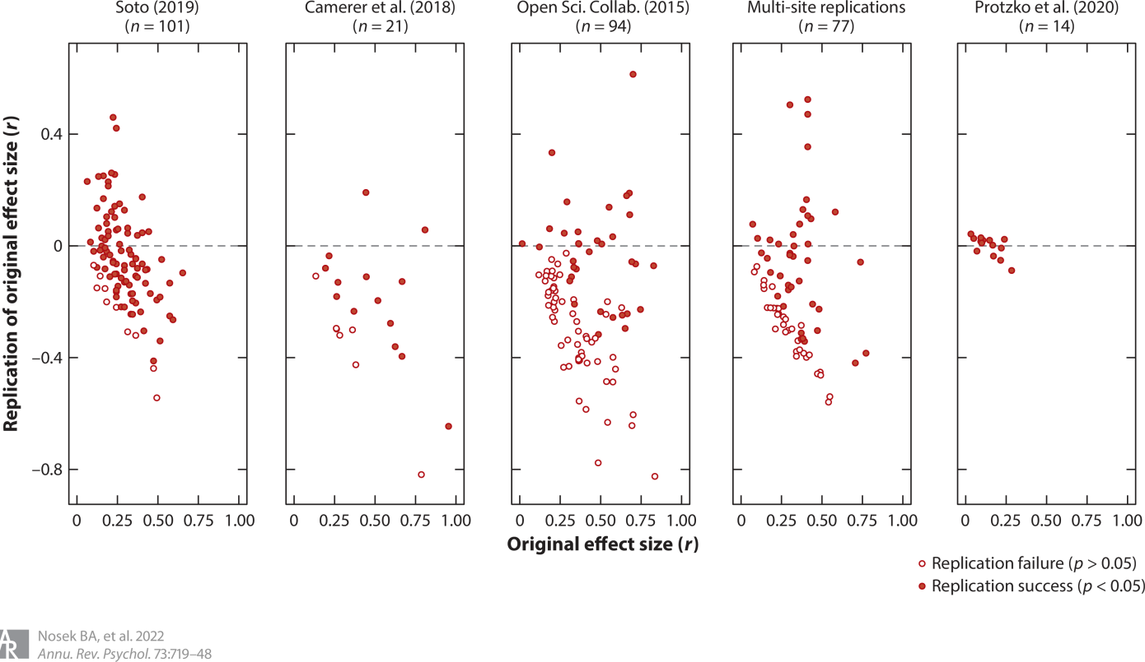
Why bother? The Replication Crisis in Psychology
Only 30-70% of published results can be reproduced, most with vastly reduced effect sizes
Can we trust the findings that are reported in the literature?!
Nosek, B. A., Hardwicke, T. E., Moshontz, H., Allard, A., Corker, K. S., Dreber, A., ... & Vazire, S. (2022). Replicability, robustness, and reproducibility in psychological science. Annual review of psychology, 73(1), 719-748.

Slide 5
Replication Crisis – in Cognitive Psychology?
50% replication rate in Cognitive Psychology
versus
25% replication rate in Social Psychology
(Open Science Collaboration, 2015)
Why?
Open Science Collaboration. (2015). Estimating the reproducibility of psychological science. Science, 349(6251), aac4716.

Slide 6
Distinguishing Statistical Features of Cognitive Psychology?
Fairly universal effects: low between-participant variability, high generalizability
Small n, but many trials: high effective statistical power

Slide 7
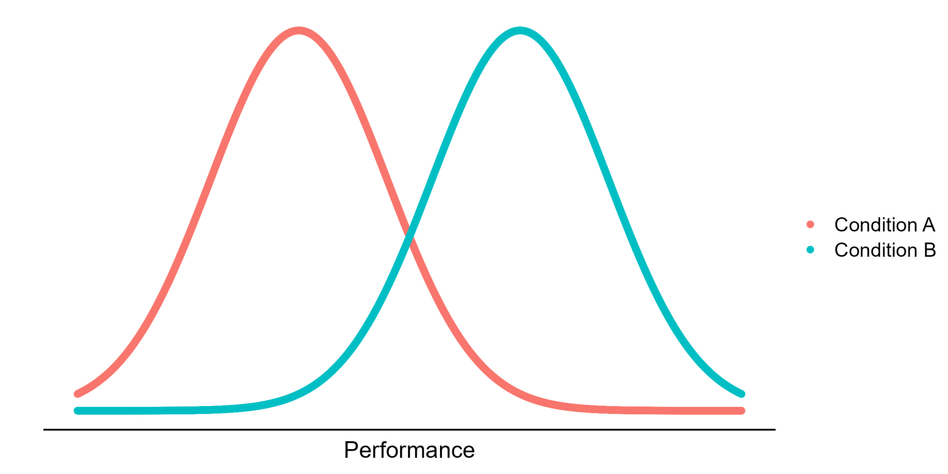
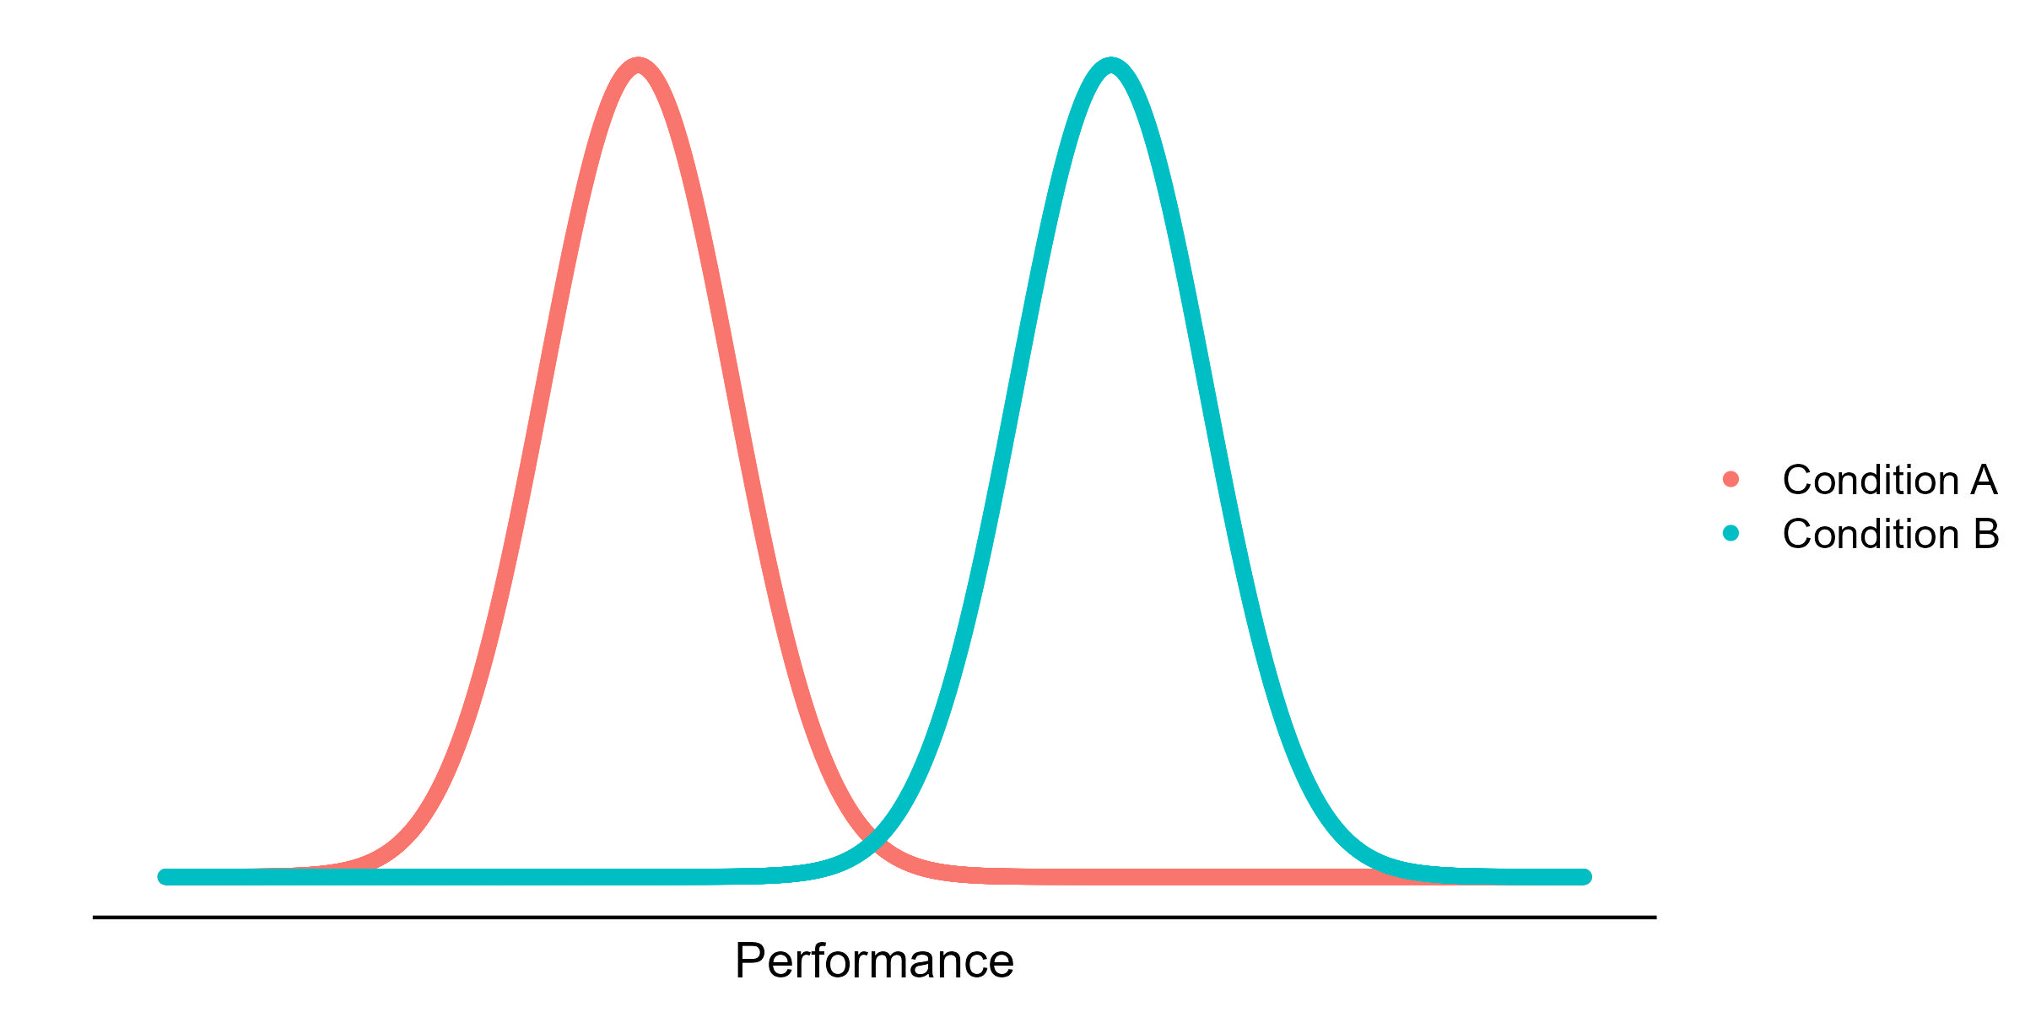
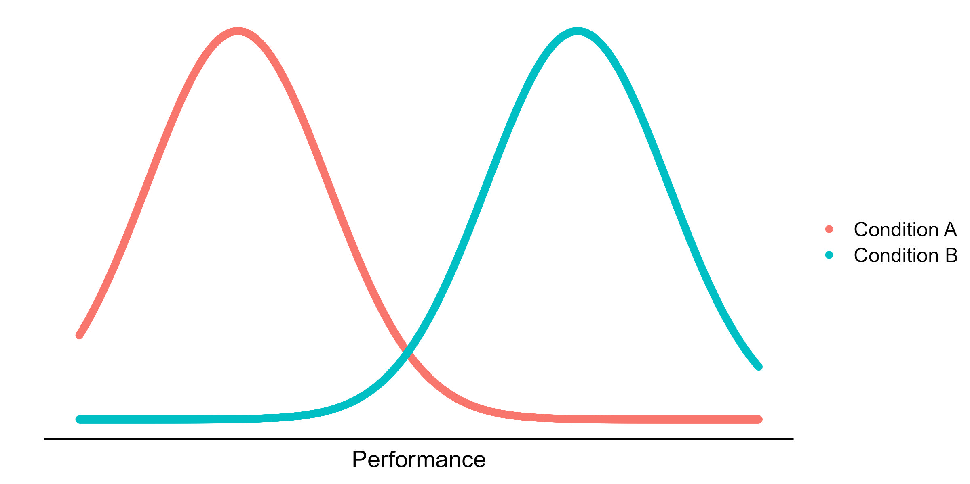

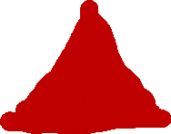
Statistical Power
Null Hypothesis Significance Testing
Determined by
Statistical test
Significance level (p = 0.05?)
Effect size:
Mean difference between conditions
Variability in performance
Sample size:
Number of participants
Number of repeat trials

Slide 8

Power analyses are great, ...
Good for science
More power = more reliable results in the literature = faster progress towards a better future or whatever
Good for you
No waste of resources (by underpowering or vastly overpowering your study)
Correctly reject the alternative hypothesis if necessary
Makes you think more thoroughly about your design and data
Makes you look cool (people are more likely to believe you)
(Christley, 2010; Turner et al., 2013)

Slide 9
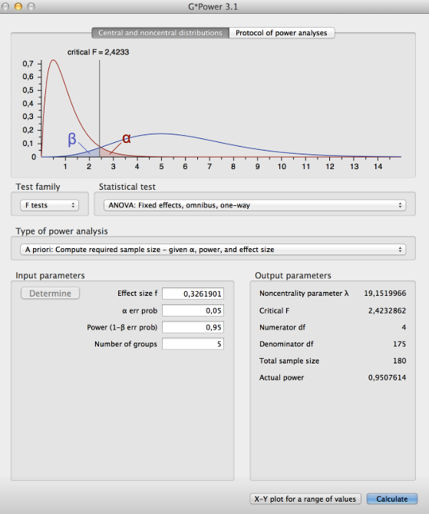
... but you gotta DO them! That‘s work!
(And we‘re all TIRED)
Easy for simple statistical designs
t tests
ANOVAs, maybe
... with tools like G power (https://www.psychologie.hhu.de/arbeitsgruppen/allgemeine-psychologie-und-arbeitspsychologie/gpower)
But even a repeated measures ANOVA is already a challenge for these tools

Slide 10
POWER ANALYSES VIA SIMULATIONS
(Debruine & Barr, 2021; Brysbaert & Stevens, 2018)

Slide 11
The general process
SIMULATING: We simulate 1000 verisimilar datasets for different numbers of trials and participants
ANALYZING: We analyze each of these simulated datasets
SUCCESS!: The fraction of signficant tests is the statistical power, given the number of trials and participants

Slide 12
SIMULATING

Slide 13
Option 1: <Insert your mechanistic model>
Option 2: Simulate verisimilar data
Option 1: <Insert your mechanistic model>
Option 2: Simulate verisimilar data

Slide 14
What do you expect your data to look like?
Reuse a mechanistic model to generate the data
Rely on stuff reported in the literature
Pilot data

Slide 15
What goes into simulating 2AFC data?
Baseline accuracy
Between-participant variability
Baseline precision
Between-participant variability
Changes in accuracy due to the manipulation
Between-participant variability?
Changes in precision due to the manipulation
Between-participant variability?
Distribution of presented stimuli
Staircase?
Constant stimuli?

Slide 16
ANALYZING

Slide 17
Analyzing Psychophysical Data
Two-step approach:
Fit psychometric functions
Use fitted PSEs/JNDs as dependent variables to assess statistical significance
One-step approach (Moscatelli et al., 2012):
Assess statistical significance directly based on raw data (i.e., individual responses)

Slide 18
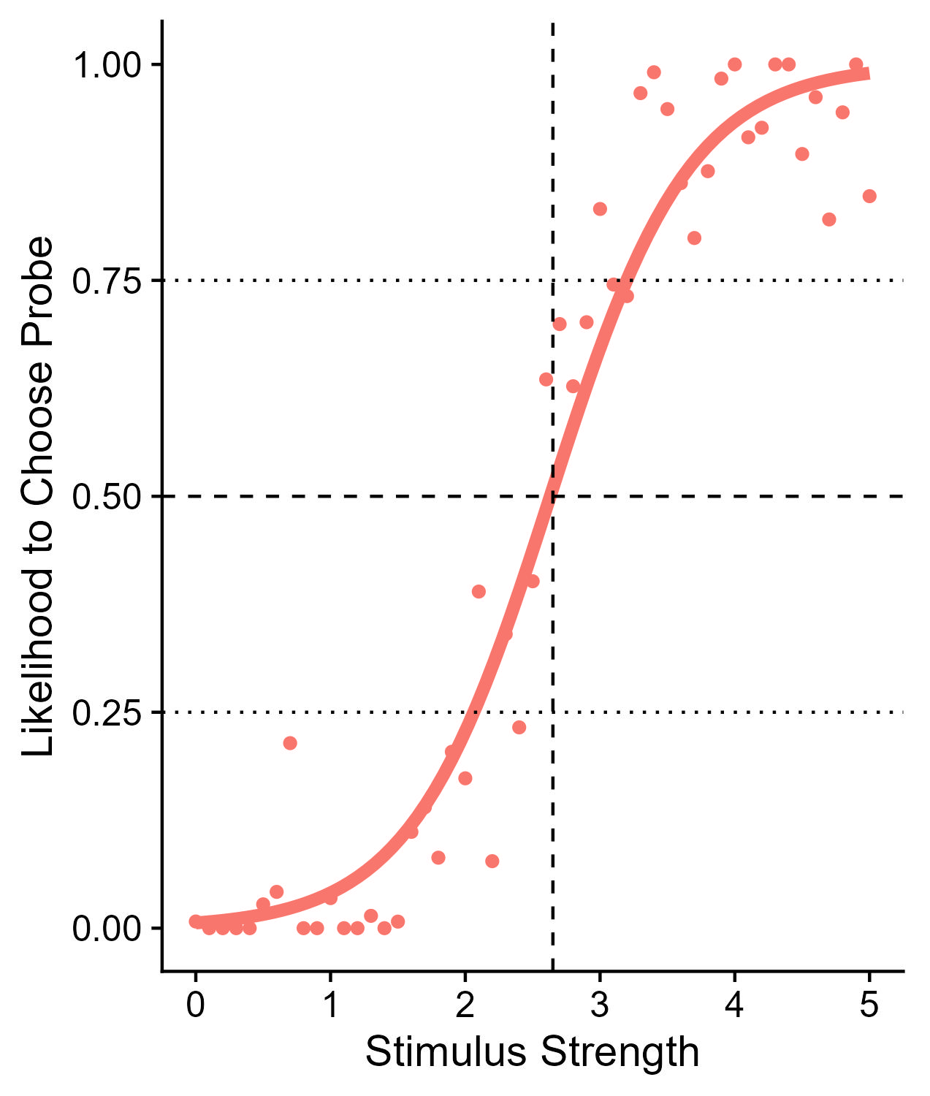
Two-Step Approach
PSE
JND
(1) Fit psychometric functions and extract PSEs and JNDs
JND

Slide 19
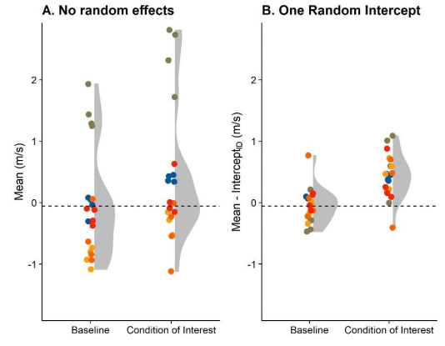
Two-Step Approach
(1) Fit psychometric functions and extract PSEs and JNDs
(2) Use PSEs and JNDs as dependent variable in analysis

Slide 20
A little foray into linear mixed models, ... (sorry)
Attribute otherwise random variability to sources, e.g.:
Baseline differences between participants
Dependent Variable ~ Experimental Manipulation + (1 | Participant)
Individual differences in how participants react to the manipulation
Dependent Variable ~ Experimental Manipulation + (Experimental Manipulation | Participant)
(Matuschek et al., 2017; Brown, 2017)

Slide 21
Dependent Variable ~ Experimental Manipulation + (1 | Participant)
Dependent Variable ~ Experimental Manipulation

Slide 22
One big downside of the two-step approach
A sizeable loss in power!

Slide 23
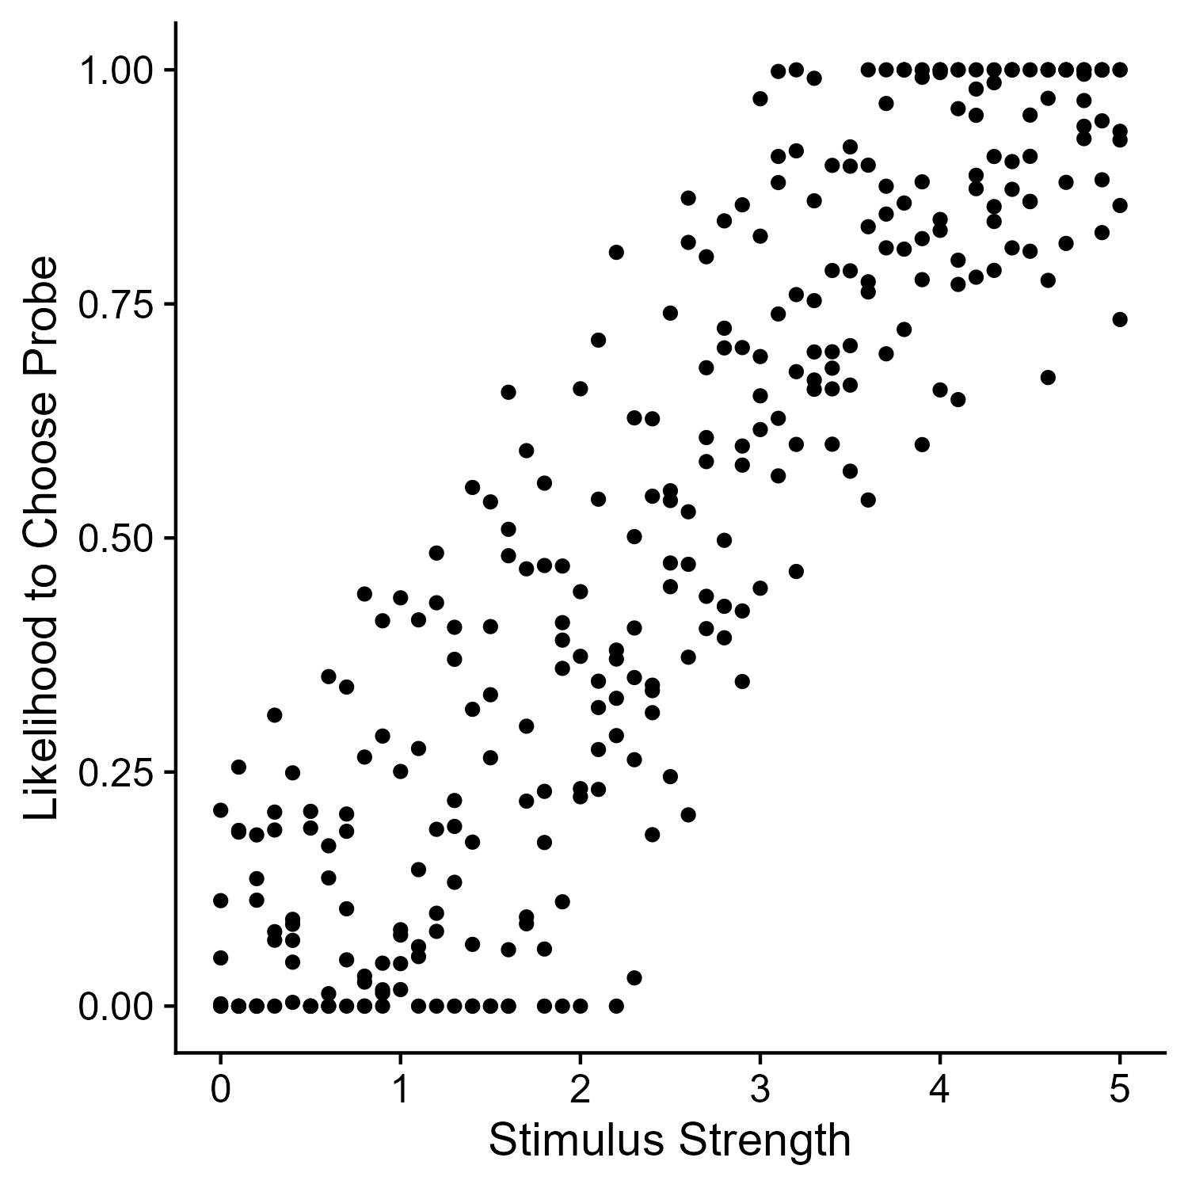
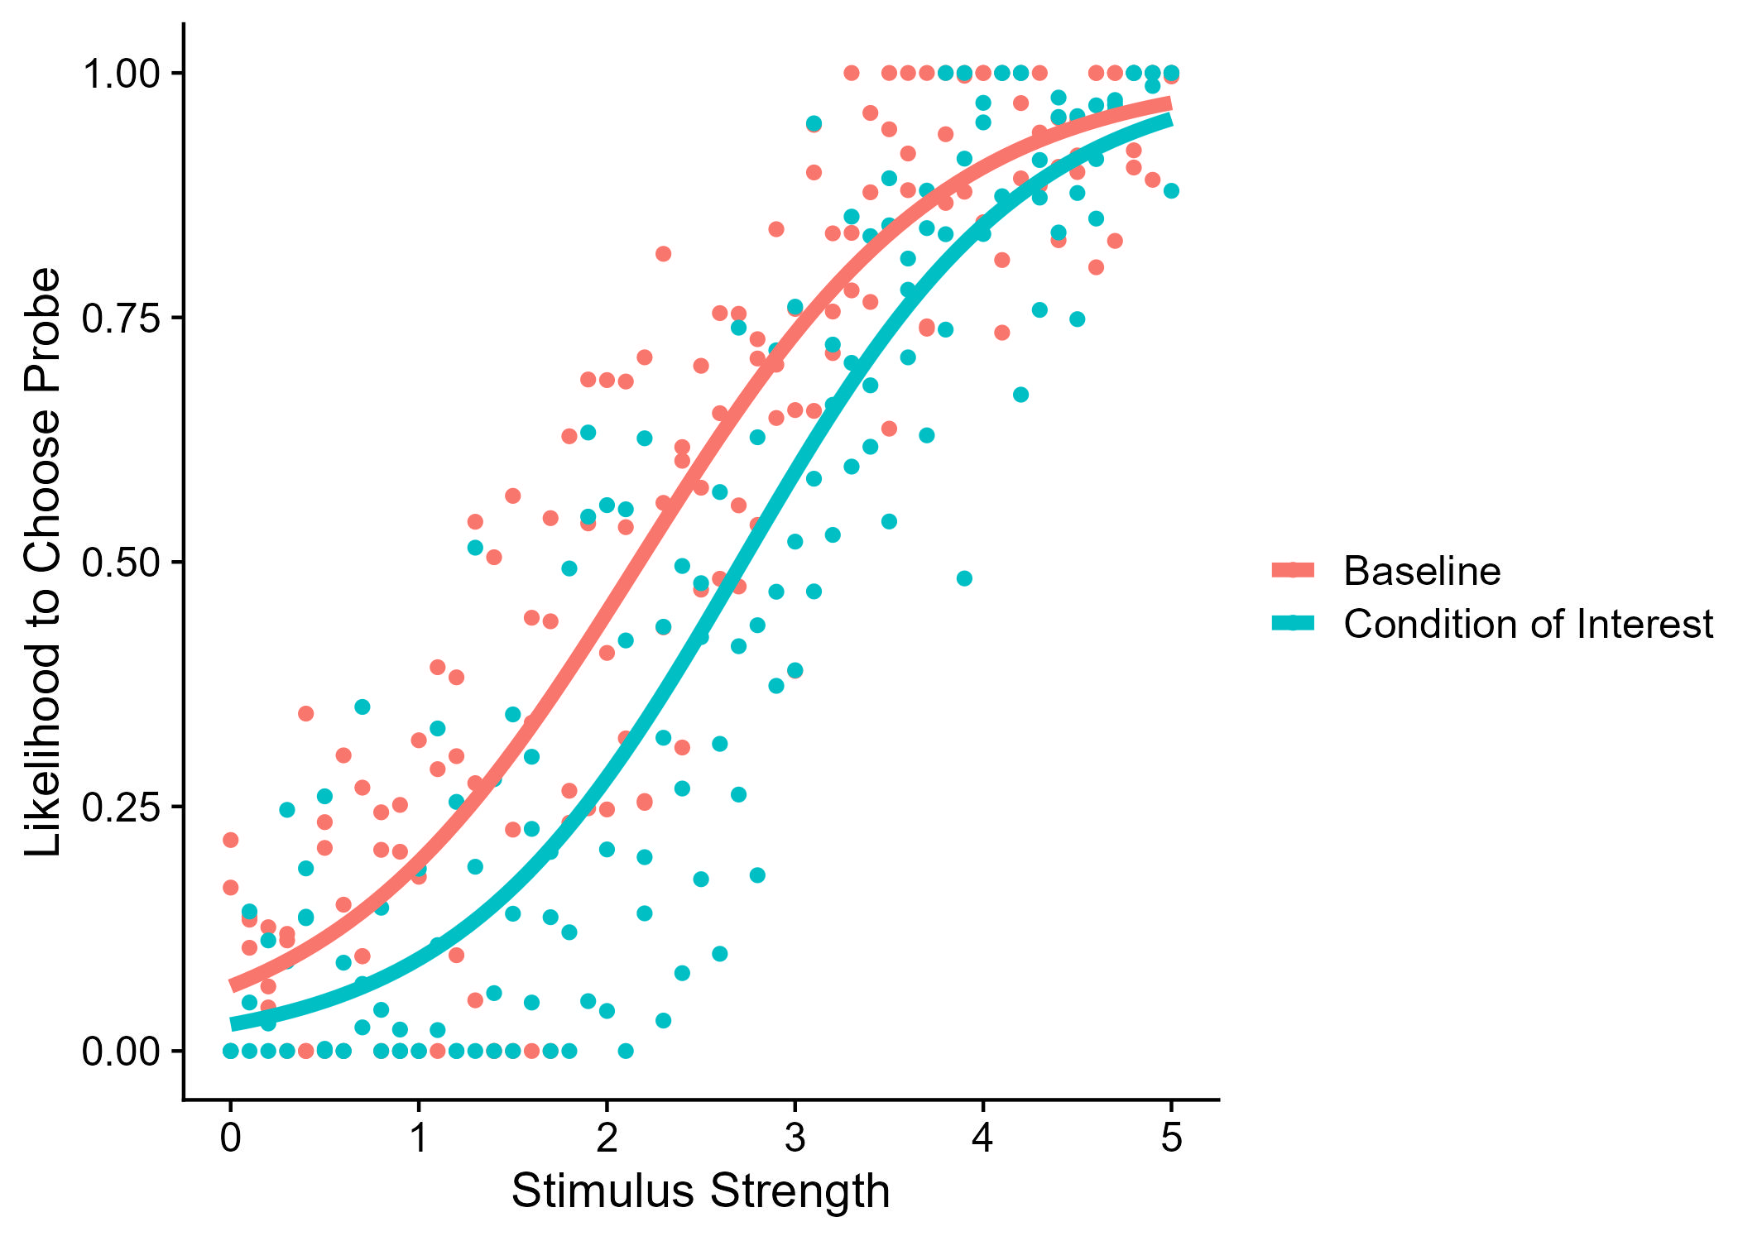
One-Step Approach
(1) Assess statistical significance directly based on raw data (i.e., individual responses)
Response ~ Stimulus Strength
Response ~ Stimulus Strength + CoI

Slide 24
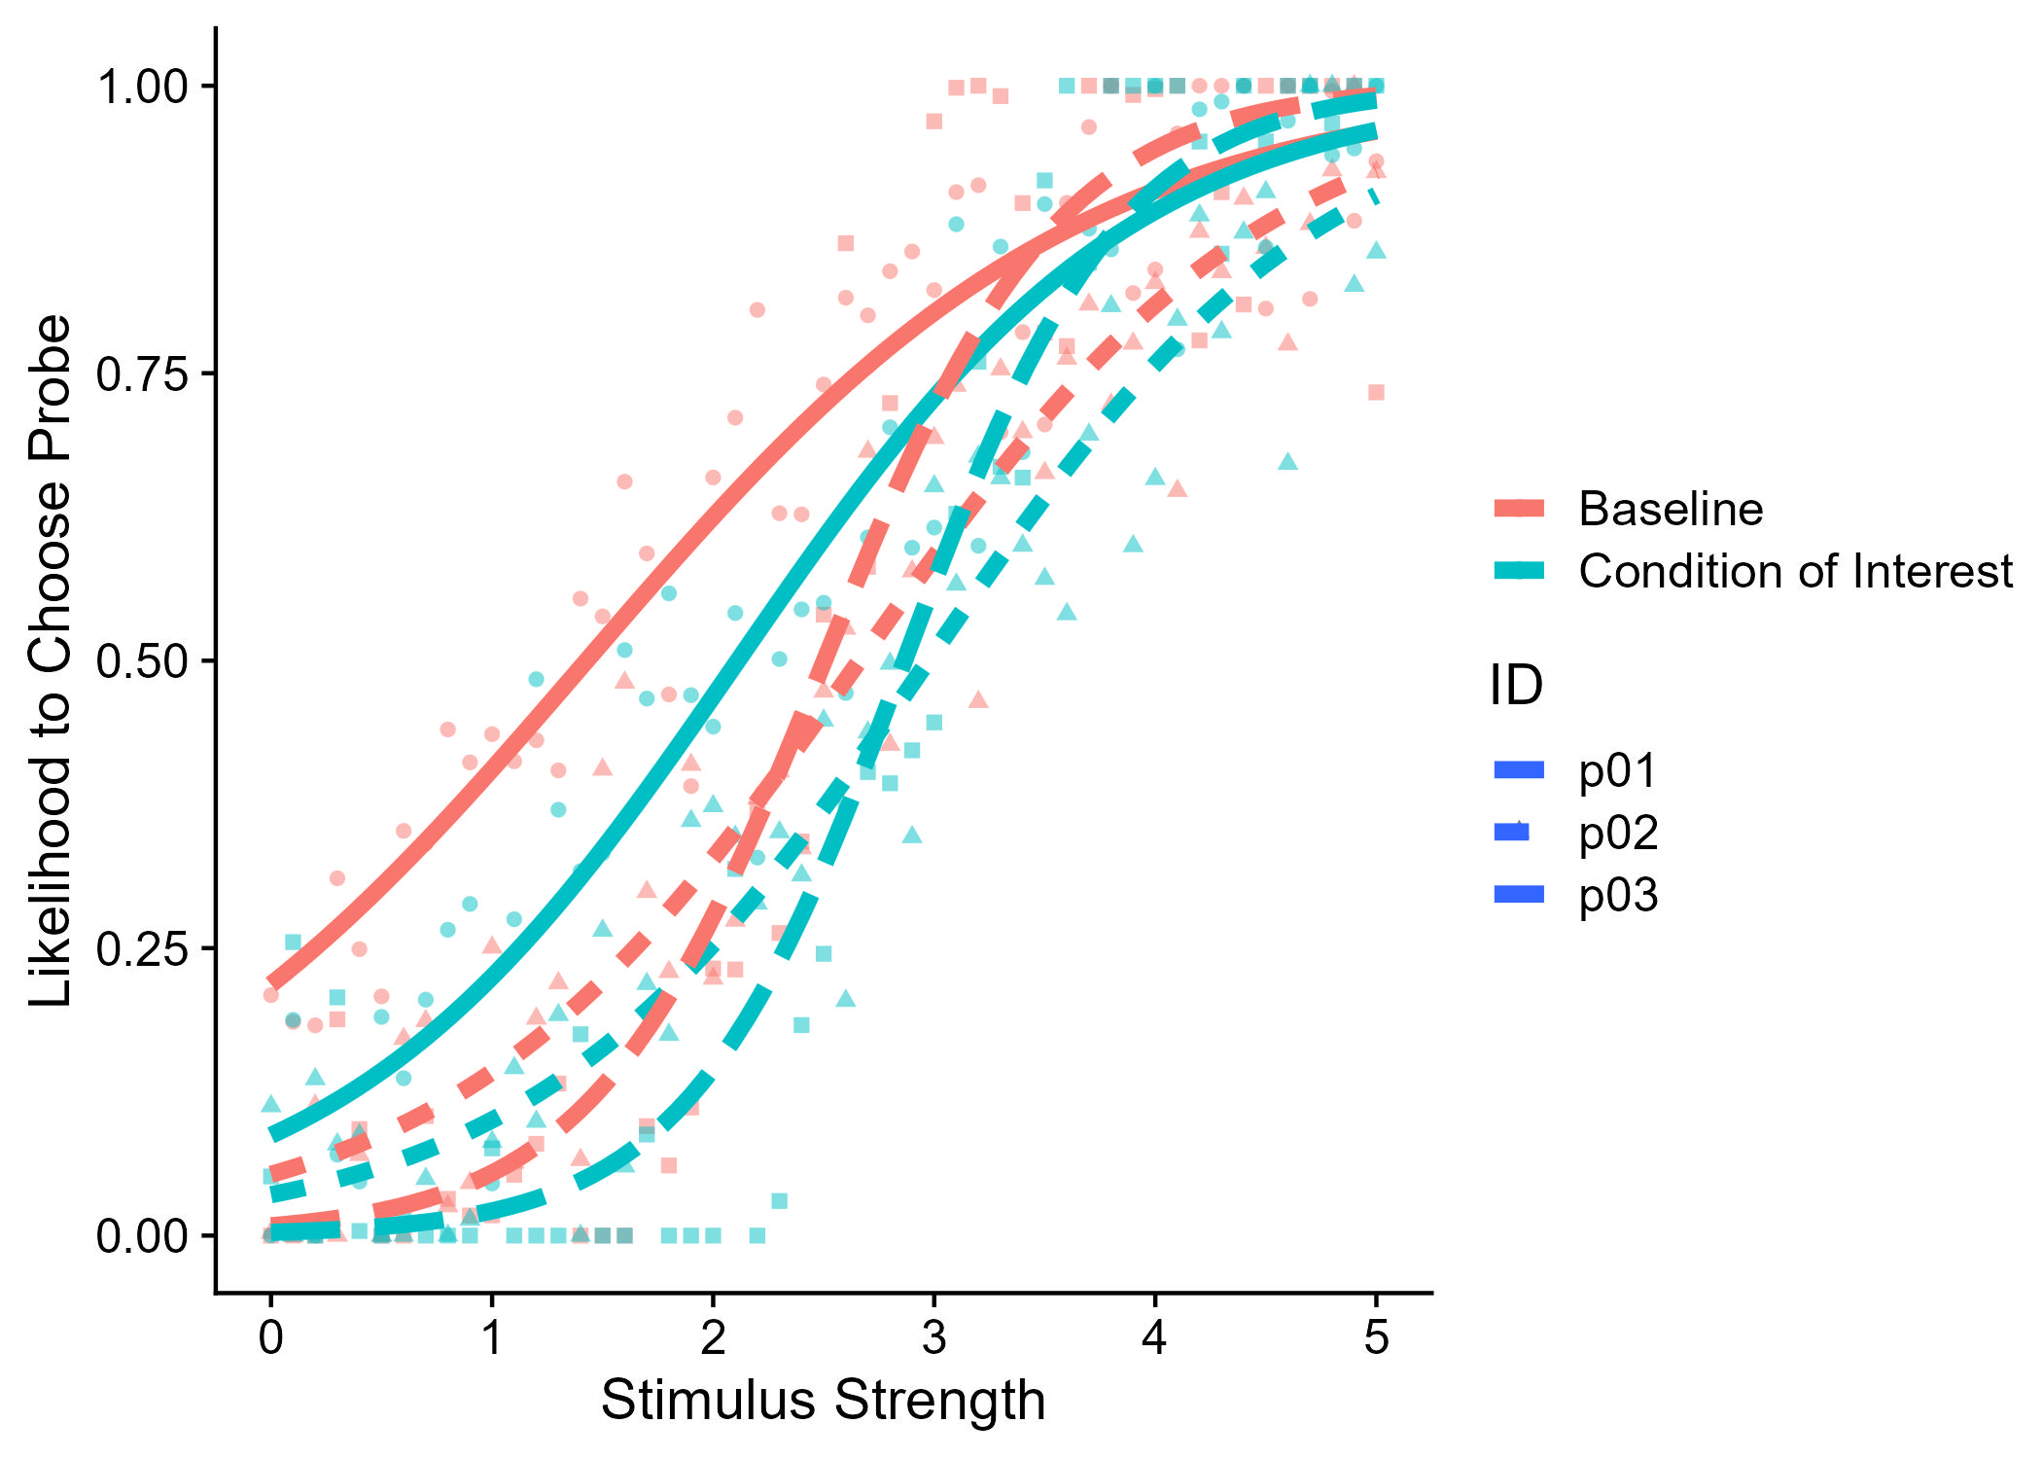
GLMMs and 2AFC data
Response ~ Stimulus Strength + CoI
Response ~ Stimulus Strength + CoI +
(Stimulus Strength | Participant)

Slide 25
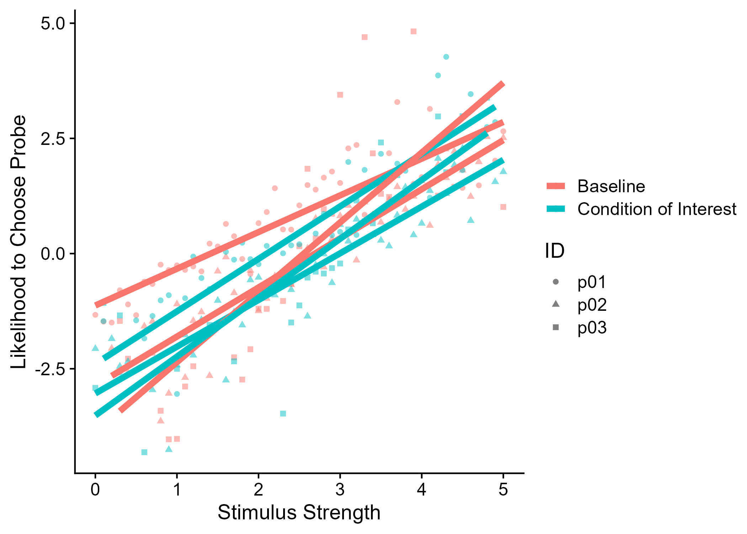

The inner working of a GLMM
Response ~ Stimulus Strength + CoI +
(Stimulus Strength | Participant)
Response ~ Stimulus Strength + CoI +
(Stimulus Strength | Participant)
link = “logit”

Slide 26
SUCCESS!

Slide 28
References
Brown, V. A. (2021). An Introduction to Linear Mixed-Effects Modeling in R. Advances in Methods and Practices in Psychological Science, 4(1), 1–19.
Brysbaert, M., & Stevens, M. (2018). Power Analysis and Effect Size in Mixed Effects Models: A Tutorial. Journal of Cognition, 1(1), 1–20. https://doi.org/10.5334/joc.10
Christley, R. M. (2010). Power and error: Increased risk of false positive results in underpowered studies. Open Epidemiology Journal, 3, 16–19. https://doi.org/10.2174/1874297101003010016
Debruine, L. M., & Barr, D. J. (2021). Understanding Mixed-Effects Models Through Data Simulation. Advances in Methods and Practices in Psychological Science, 4(1), 1–15. https://doi.org/10.1177/2515245920965119
Matuschek, H., Kliegl, R., Vasishth, S., Baayen, H., & Bates, D. (2017). Balancing Type I error and power in linear mixed models. Journal of Memory and Language, 94, 305–315. https://doi.org/10.1016/j.jml.2017.01.001
Maxwell, S. E. (2004). The persistence of underpowered studies in psychological research: Causes, consequences, and remedies. Psychological Methods, 9(2), 147–163. https://doi.org/10.1037/1082-989X.9.2.147
Moscatelli, A., Mezzetti, M., & Lacquaniti, F. (2012). Modeling psychophysical data at the population-level: The generalized linear mixed model. Journal of Vision, 12(11), 1–17. https://doi.org/10.1167/12.11.26
Turner, R. M., Bird, S. M., & Higgins, J. P. T. (2013). The Impact of Study Size on Meta-analyses: Examination of Underpowered Studies in Cochrane Reviews. PLoS ONE, 8(3), 1–8. https://doi.org/10.1371/journal.pone.0059202

